Slide 1


Traffic
Congestion

Slide 2



INTRODUCTION
PROBLEM STATEMENT
RESEARCH PROCESS
FORECASTING
RECOMMENDATIONS
01
02
03
04
05
Notes:
Today our team will present our research regarding traffic congestion along the I-70 corridor. We will discuss the problems and impact caused by congestion. We will discuss our research and data preparation processes. Next we will discuss our findings. And lastly, we will provide data-driven recommendations for alleviating the ever growing traffic congestion issues along I-70.

Slide 3


I-70 Traffic Congestion
Traffic on I-70 through the Rocky Mountains of Colorado plays a critical role in business, tourism, and the overall well-being for Colorado residents. The goal of our analysis was to determine proactive measures to attempt to minimize major disruptions and improve overall highway efficiency.
We conducted both historical traffic analysis as well as developed forecasting for the remainder of 2017. This report provides key findings, analytical insights, and multiple data-driven recommendations to enhance traffic management strategies including traditional methods as well as potential powerful AI solutions
Notes:
Our team of data analysts, including myself Helena, along with Lauren and Isuri, were tasked with reviewing data provided outlining the average daily traffic numbers registered at the Wolcott traffic station on I-70 on the western slope of Colorado’s Rocky Mountains. It included counts from both east and west bound traffic. The data we were provided covers the span of January 2005 through February 2017.

Slide 4




Research Process
#
Data Preparation & Exploration
Review congestion data
Locate gas price, temperature, precipitation, and snowfall data
Verify all historical data accurate and complete
Complete preliminary analysis for general summary statistics including averages, counts, minimum, and maximum values
Look for potential correlation between traffic congestion and other potentially impacting factors
Notes:
We were provided a data file that included just monthly traffic count data from the Wolcott traffic station on I-70 from January 2005 through February 2017. To supplement this single point of data, we researched other potential factors that may influence congestion and traffic flow. We located a data source from the State of Colorado that provided weekly gas price averages available for the same time-frame as the traffic count data. We were able to transform this into monthly data to coincide with the given traffic data. Additionally, we located weather data from CSU’s Colorado Climate Center. There was not data from specifically Wolcott but we were able to locate weather data from the Vail weather station which is still within Eagle County and approximately 20 miles east of Wolcott. Given the proximity on I-70, we decided this city would be a good indicator of temperature, precipitation, and snowfall amounts in the general area of the traffic station. We transformed all the new data into a single data source to use in our analysis. Initially we reviewed all the summary statistics of the potentially impacts to traffic and attempted to find a correlation between traffic and any of these features.

Slide 5

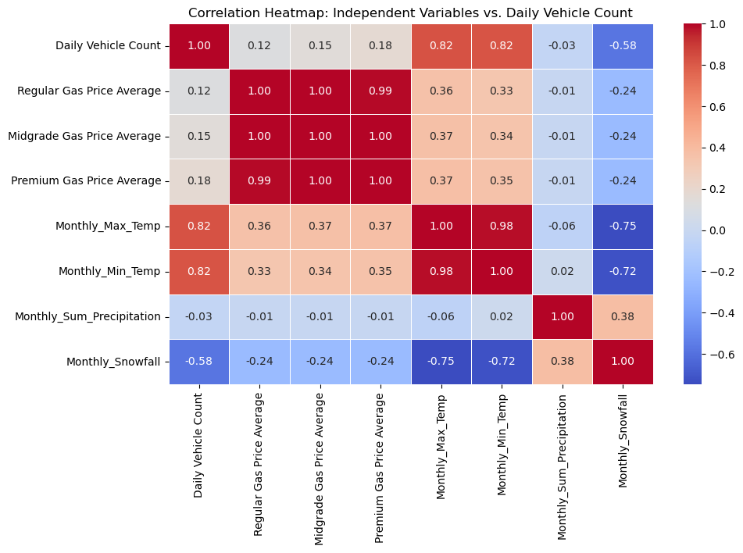

Potential Impacting Factors
Monthly Maximum Temperature
Monthly Minimum Temperature
Regular Gas Price Average
Monthly Snowfall
Correlation
Notes:
We created this correlation chart to determine potential impacting factors on traffic congestion. Some showed little to no correlation value as it relates to traffic count. We determined that we would utilize monthly minimum and maximum temperatures, monthly snowfall amounts, as well as regular gas price averages for further consideration on impact to traffic. The weather factors had a potential strong correlation and the gas price looked nominal but we wanted to see if it may have impact as well.

Slide 6

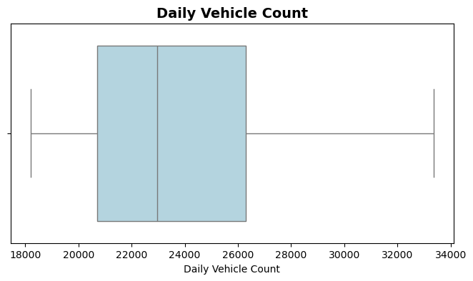
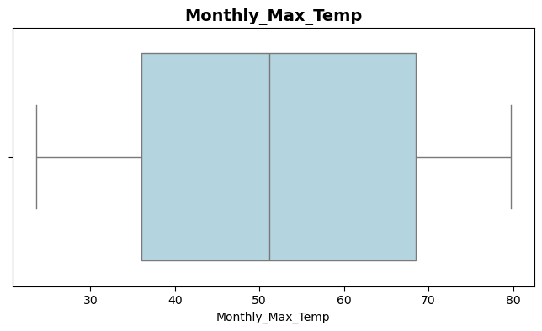
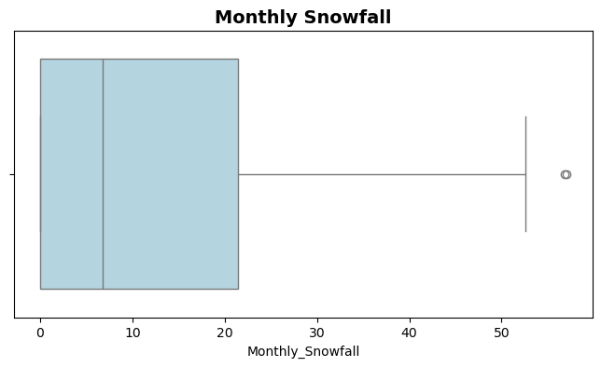
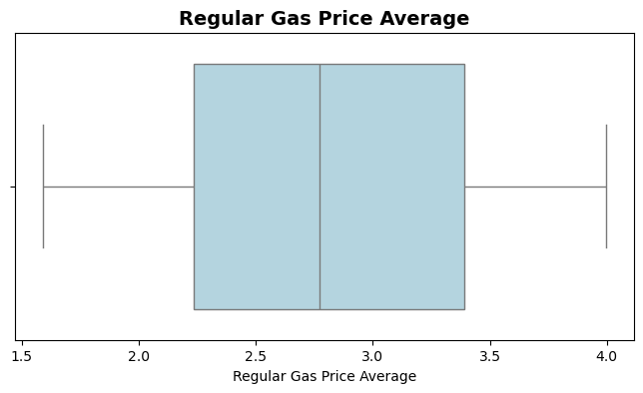
Data Distribution
Notes:
Some of our preliminary research showed that our data might contain some outlying values that could potentially impact our results. Using these boxplot graphs, we saw that most were fairly normally distributed but monthly snowfall had quite a few outliers along with multiple zero values impacting the distribution. Looking at the seasonality of snowfall, we believe this data is still accurate and could be used to strengthening our analysis of traffic congestion, especially comparing seasonality of traffic congestion.

Slide 7

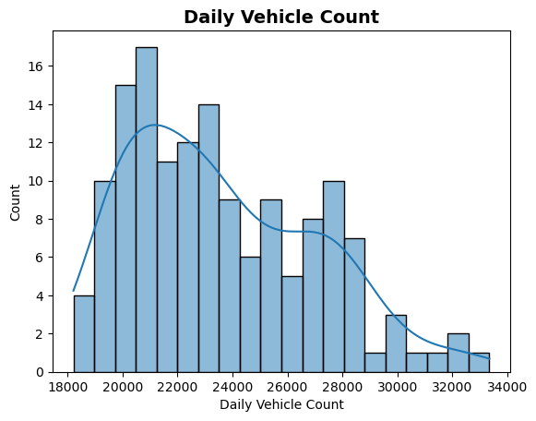
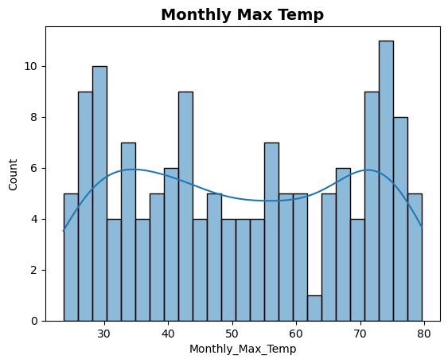
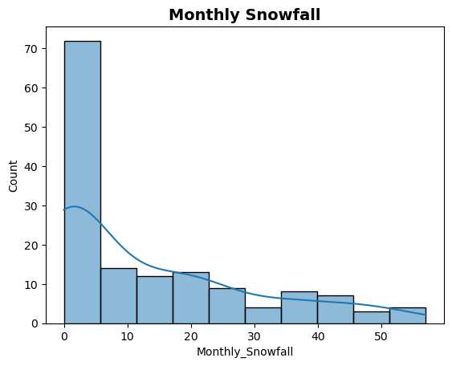
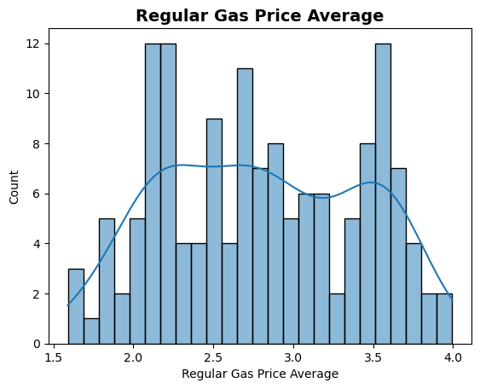
Data Distribution
Notes:
Here is a secondary view confirming distributions of our data.

Slide 8
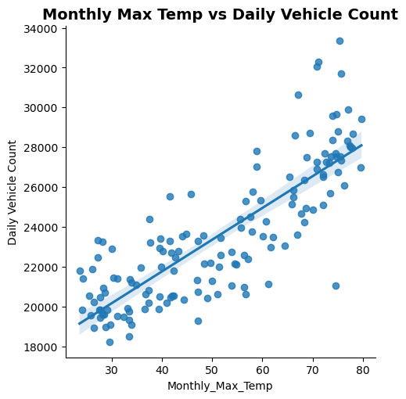
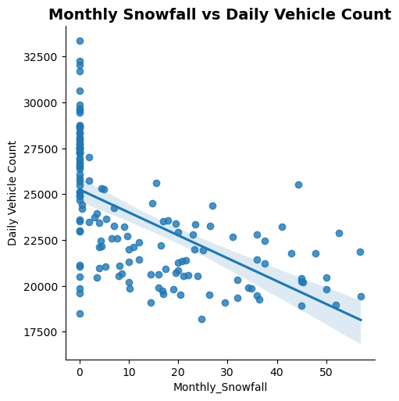
Feature Relationships
Notes:
These visualization gave us some insight on what we might find through our continued research into the relationships between external factors and traffic congestion. On the left, you can see a strong positive correlation between maximum temperatures and count of vehicles. As the monthly maximum temperature increases, the count of vehicles increases as well. Conversely, on the right, you can see that when snowfall amounts increase, the number of vehicles decreases. This shows a strong negative correlation.

Slide 9
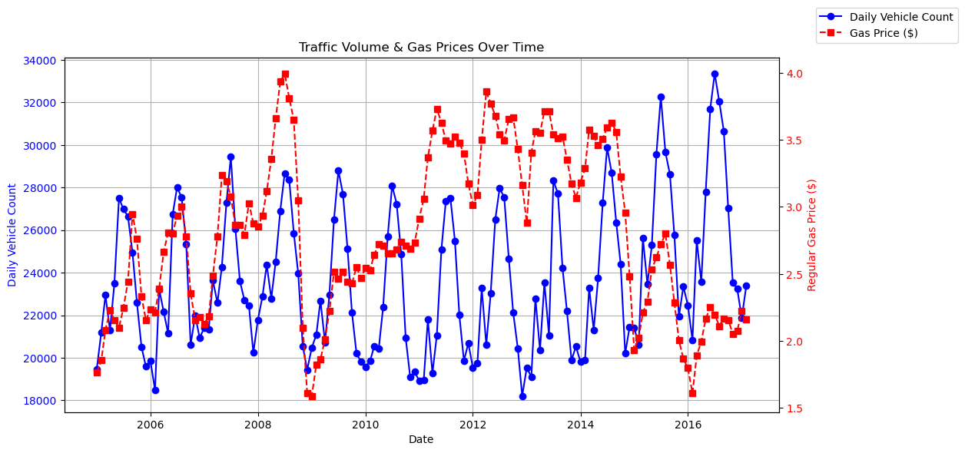
Traffic Volume and Gas Prices
Notes:
Our last preliminary research finding relates to gas prices and traffic volume. This chart shows a clear trend showing a decrease in vehicle volume immediately following higher gas prices. There are some outliers from this trend but, overall, we felt that gas prices could potentially impact traffic volume.

Slide 10


Descriptive Analysis

Slide 11
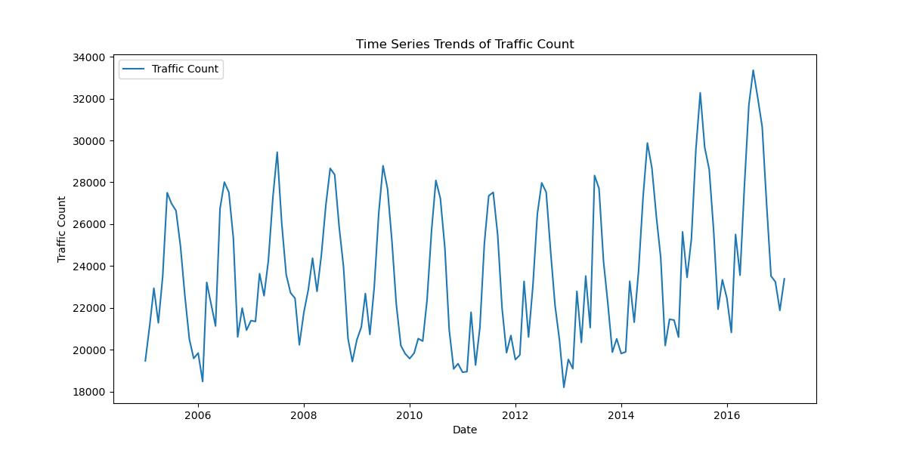
Time Series Trends and Traffic Count

Slide 12
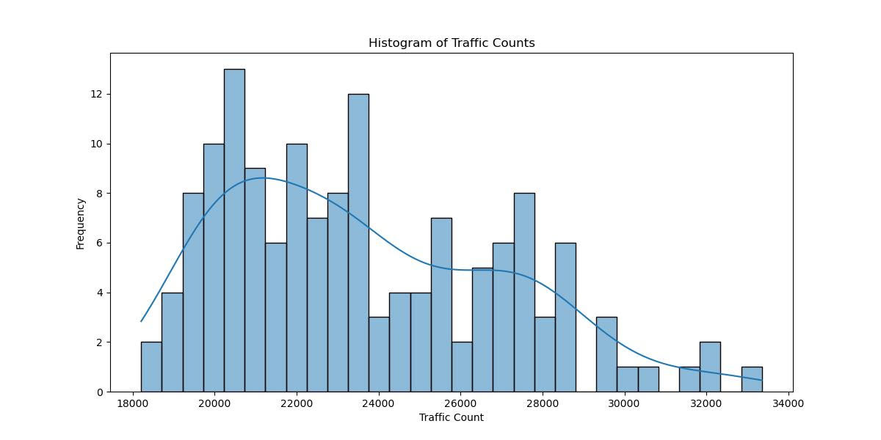
Histogram of Traffic Counts

Slide 13
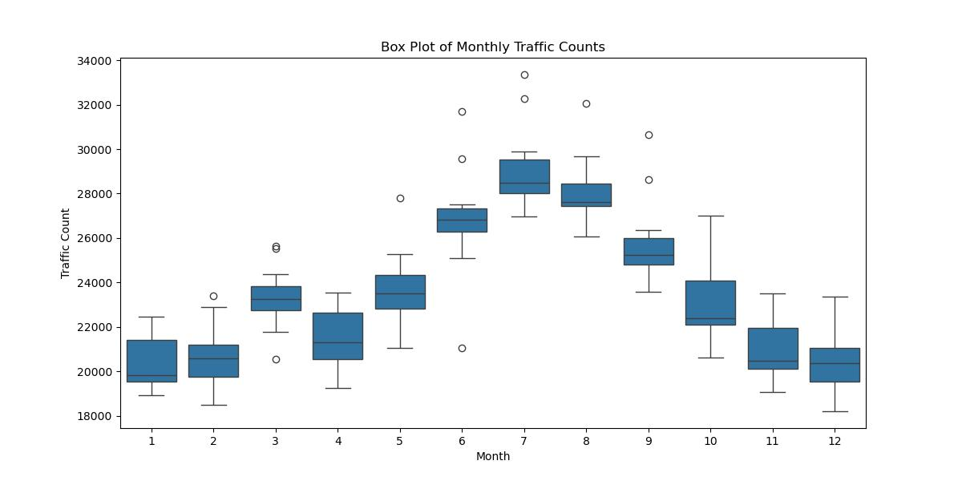
Box Plot of Monthly Traffic Counts

Slide 14
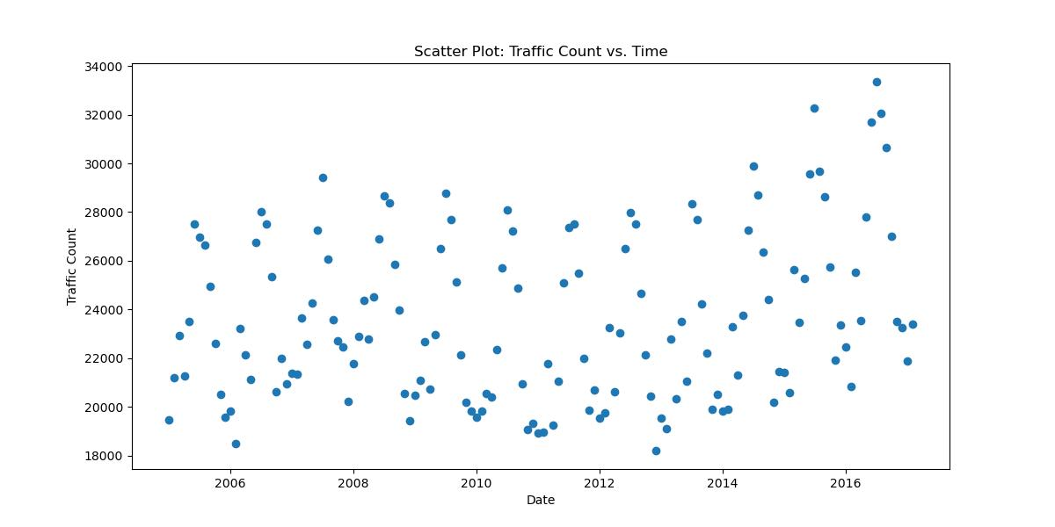
Scatter Plot: Traffic Count vs Time

Slide 15



Statistical and Predictive Analysis

Slide 16
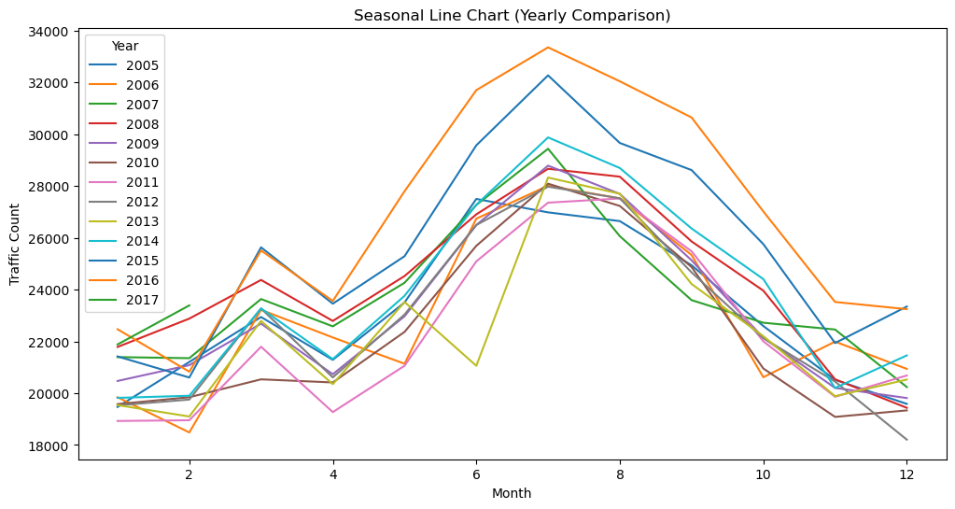
Seasonal Line Chart

Slide 17
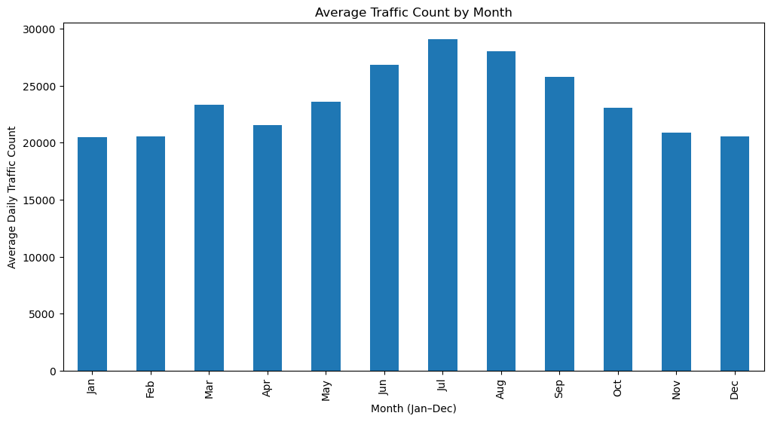
Average Traffic Count by Month
Notes:
.

Slide 18
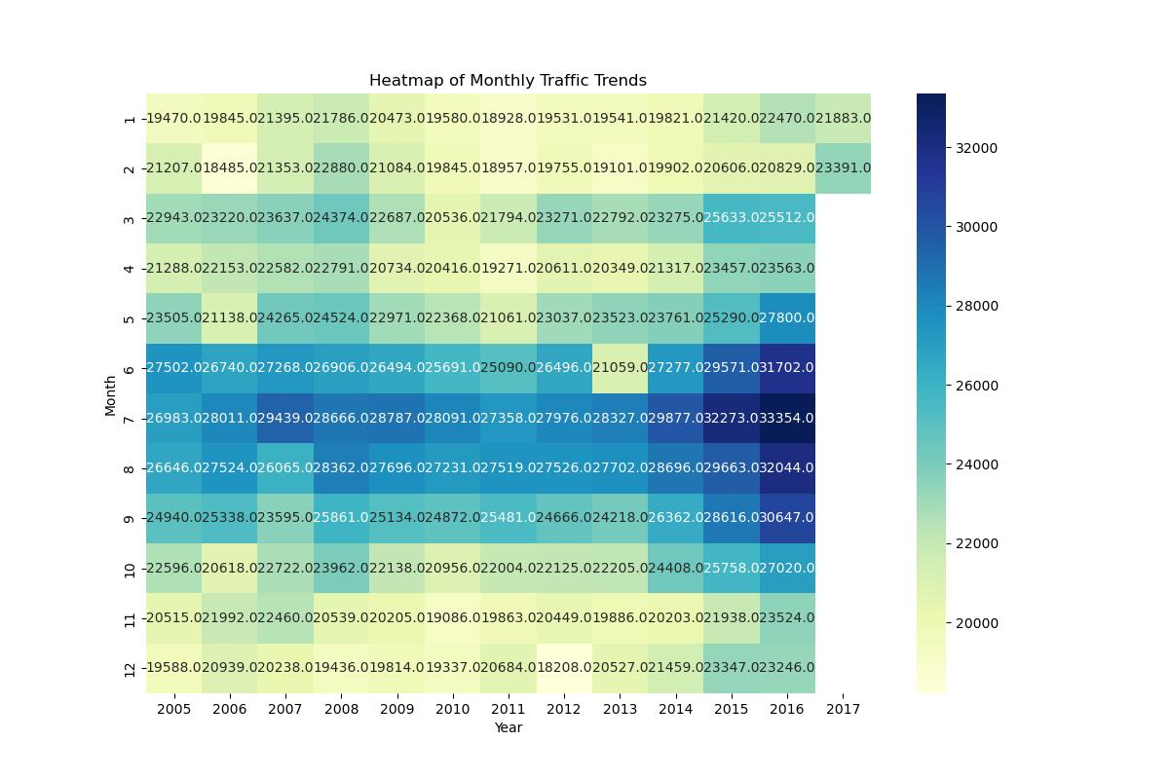
Heatmap of Monthly Traffic Trends

Slide 19



#
Forecasting Traffic for the Rest of 2017

Slide 20
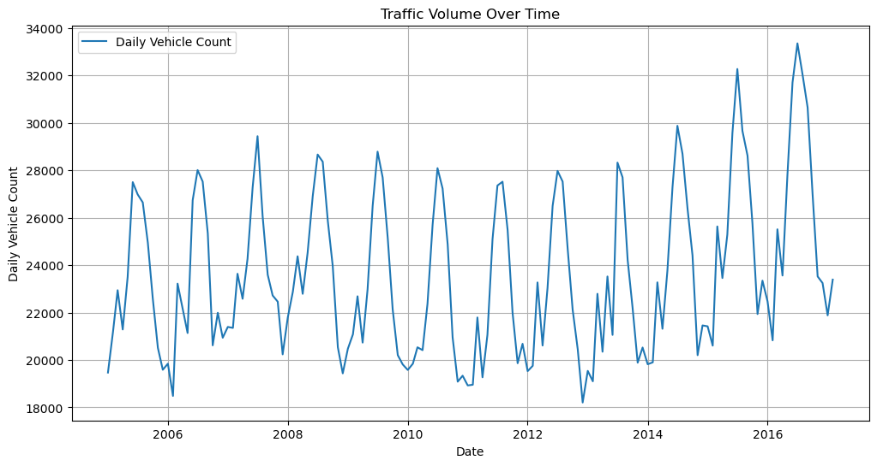
#
Traffic Volume Over Time

Slide 21
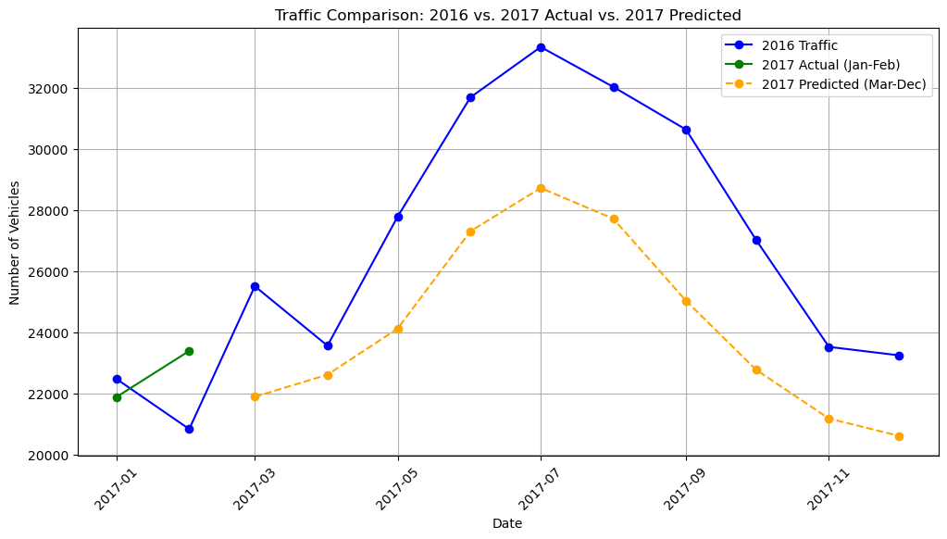

Modeling Predictions
Notes:
We completed extensive research on the original dataset provided and were able to provide a model with 75.7% confidence that maximum temperature, regular gas price averages, and seasonality are statistically significant to traffic congestion. Using that model, as well as others, we were able to predict traffic for the remaining months in 2017. This graph show a comparison of one of our predictions to the actual count of vehicles in 2016 and early 2017.

Slide 22
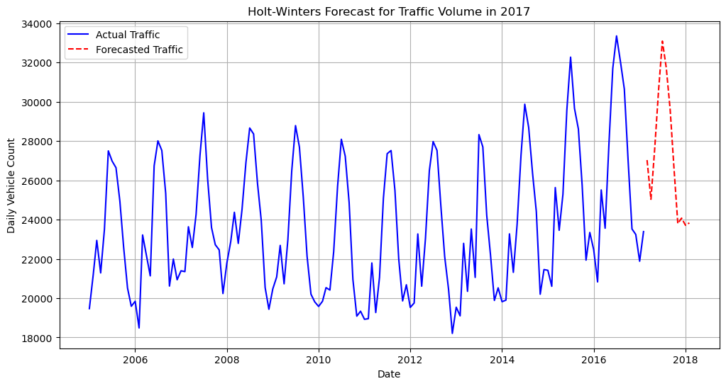
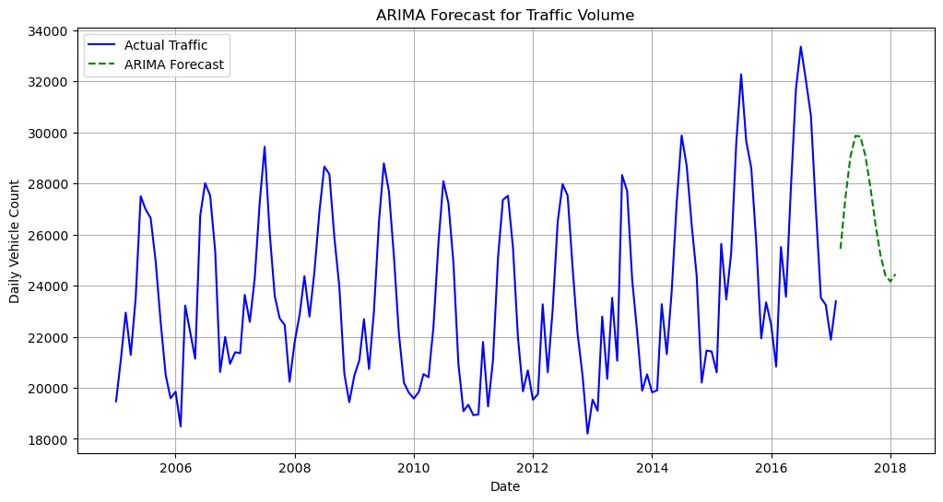
ARIMA Forecast
Holt- Winters Forecast

Slide 23
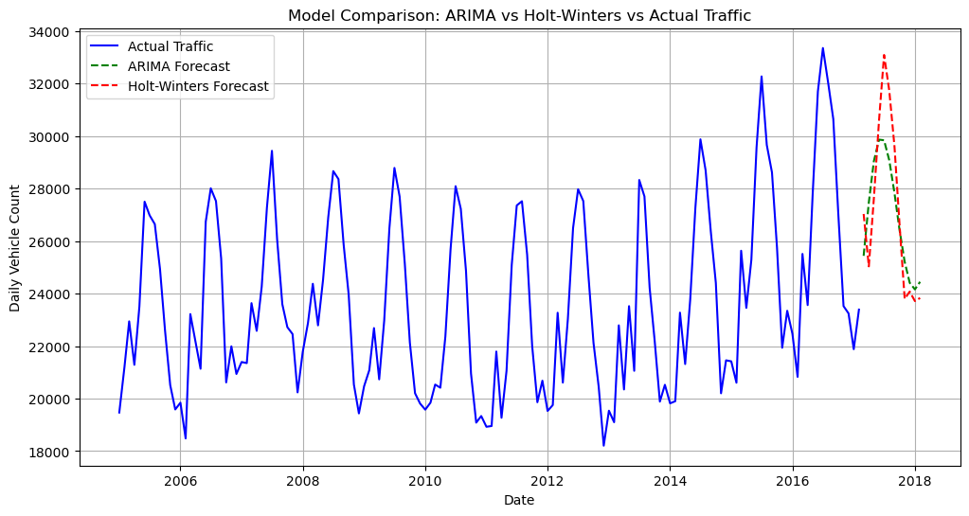
ARIMA vs Holt-Winters

Slide 24

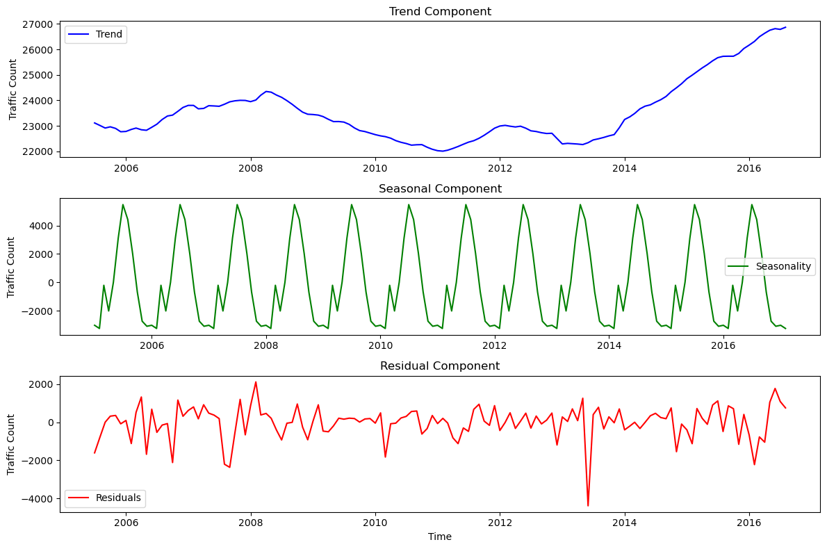

Slide 25
Recommendations

Slide 26
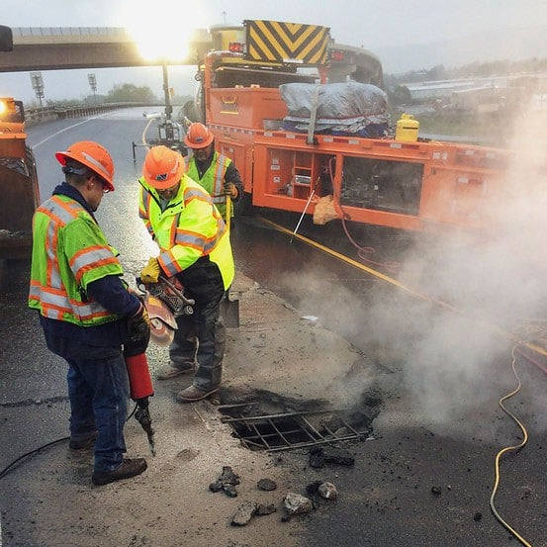


Recommendations

Slide 27
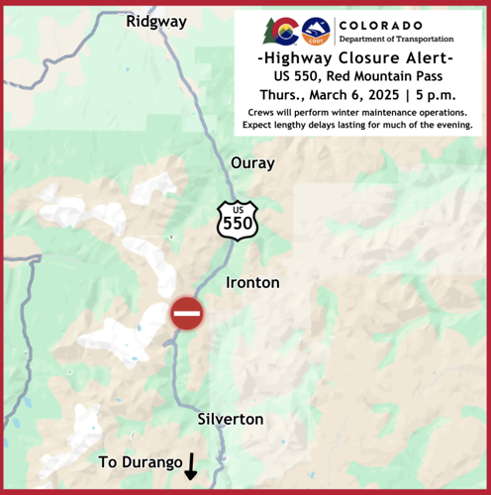


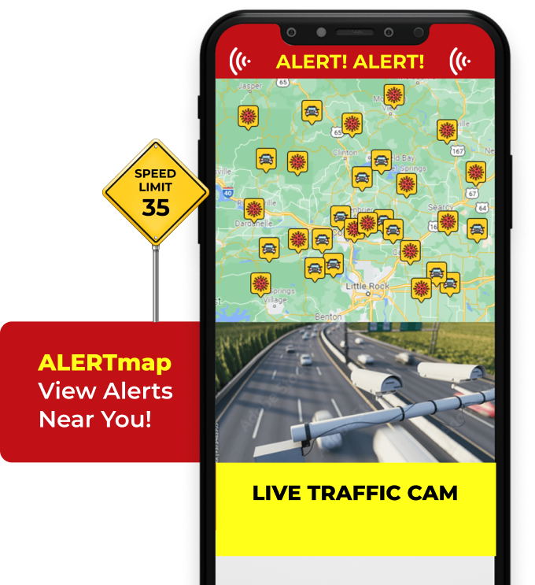
Recommendations

Slide 28



Recommendations

Slide 29
Thank You

